Slide 1
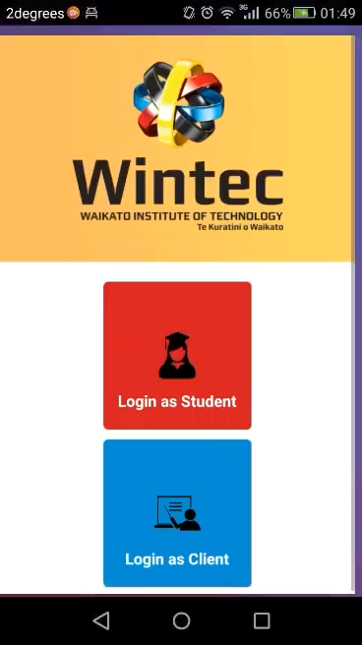
Click Login as Student
2. Before you enter your username and password, we must register by clicking Sign Up.
3. Enter your username and password of choice and click Register, then login.
4. Now you can enter your username and password and click login.
You can use the same username and password to login at any time.

Slide 2

After logging in select a pathway
2. Select any module to display more information
3. Click the X to close the popup
4. Click or swipe to access the other modules.

